Slide 1

Power Curve Working Group Update
Roskilde
26th June 2015

Slide 2
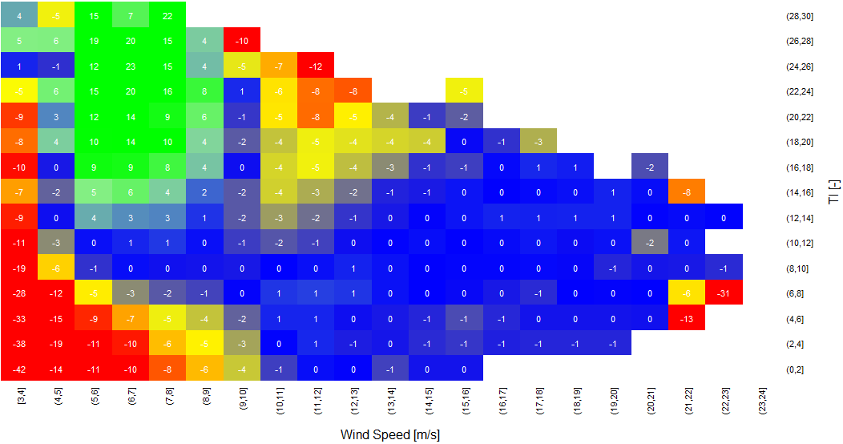
The Power Curve Working Group
The PCWG aims to further refine the accuracy energy yield predictions to improve investor confidence.
The PCWG has over 200 members across 80 organisations.
The PCWG is focused on accurately predicting wind turbine performance in ‘non-standard’ (outer range) atmospheric conditions e.g. low/high shear/veer, low/high turbulence, inflow etc.
Colour = % Power Deviation
Turbulence Intensity [%]
Wind Speed [m/s]

Slide 3
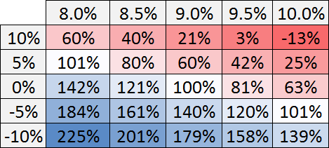
Impact of Investment Risk on Project Economics
Investors quantify risk using a discount rate (also called a hurdle rate). The discount rate expresses an expectation of return for a given level of risk.
Net present value (NPV) can be interpreted as the money left over after an investor’s expectation if return has been satisfied.
Examine impact of cost reduction and discount rate on NPV (illustrative numbers only)
Define cost reduction factor r
Discount Rate
Reducing of investment risk and reducing of costs has similar impact on project economics
Cost
Increasing Cost
Increasing Risk

Slide 4
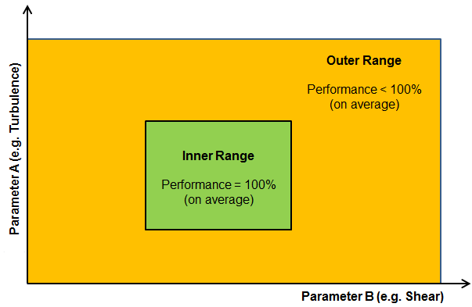
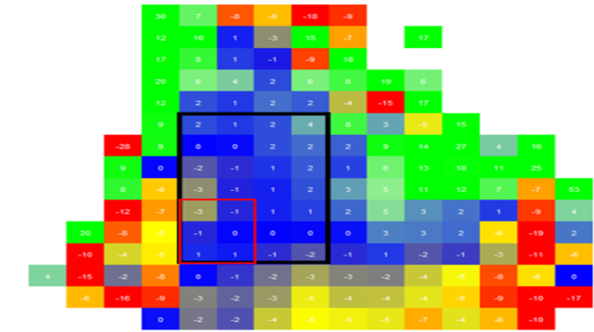
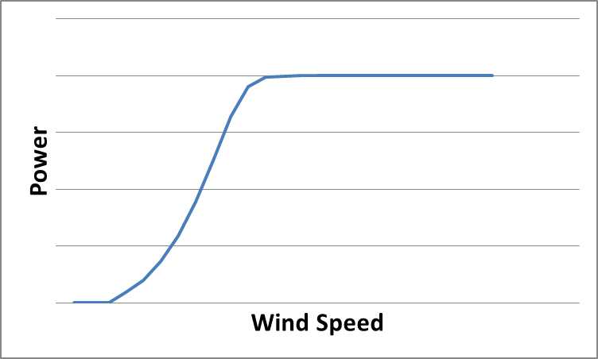
PCWG Key Concept: Inner/Outer Range
In Dec 2013 the PCWG published a document on the Inner/Outer Range Proposal (see www.pcwg.org).
Inner/Outer Range proposal is a concept developed to assist technical and contractual discussions relating to turbine performance in real world conditions.

Slide 5
PCWG 2015 Roadmap Themes
PCWG Open Source Analysis Tool
Intelligence Sharing Initiative
Open Source Excel Benchmarks
Harmonised
Stakeholder Communication
Openness is a key principle, all historic proceedings are available online at
www.pcwg.org

Slide 6
PCWG 2015 Roadmap – A3 Format
Background
(Reasons for Action)
Reasons for gap between current and target states
Current Industry State
(Where we are now)
PCWG 2015 Actions
What we are doing to close gap and achieve target state
Target Industry State
(Where we need to be)
Insights/Observations
Download PCWG 2015 Roadmap from www.pcwg.org

Slide 7
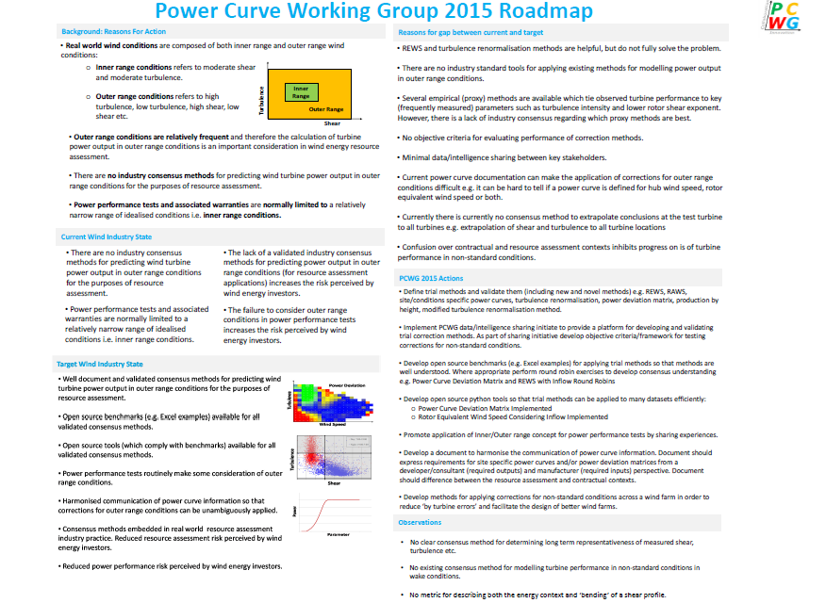
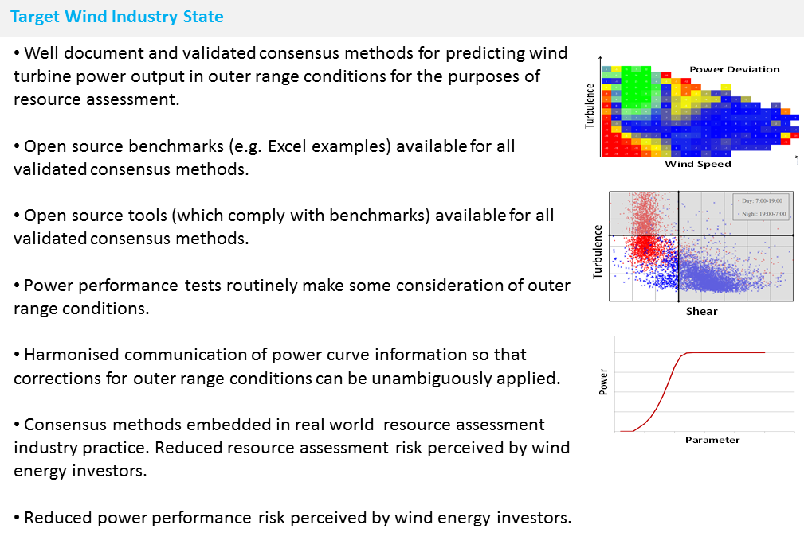
Download PCWG 2015 Roadmap from www.pcwg.org

Slide 8
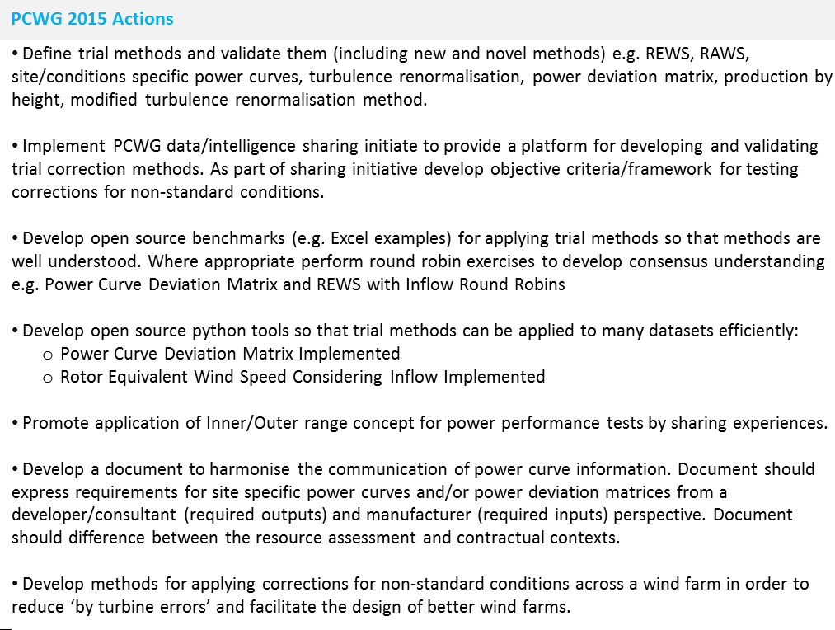
Intelligence Sharing Initiative
Turbine Performance Information Pack
Download PCWG 2015 Roadmap from www.pcwg.org

Slide 9
PCWG Intelligence Sharing Initiative
A key focus of the PCWG during 2015 is the 1st PCWG Intelligence Sharing Initiative (PCWG-Share-01).
The initiative aims to aggregate information across organization boundaries in order to deliver a step change in industry understanding of turbine performance.
Propose
Test
Aggregate
Disseminate
Decide on methods to be tested
Evaluate performance of trial methods on each individual dataset
Combine performance metrics of all datasets
Publically disseminate results
The proposed structure of PCWG-Share-01 has been captured in a “definition document” which is currently with PCWG members for comment and will be finalised at the June 2015 PCWG meeting.

Slide 10
PCWG-Share-01: Data Flow
Hypothesis/Trial Methodology
Analysis Definition Y
Analysis Definition Y
Analysis Definition Y
Analysis Definition Y
Proprietary Dataset A
Proprietary Dataset B
Proprietary Dataset C
Proprietary Dataset D
Organization A
Organization B
Organization C
Organization D
Hypothesis Performance Metrics
Aggregator
(Academic Institution )
Combination Analysis
How well did the trial method perform?
Aggregated Hypothesis Performance Metrics

Slide 11
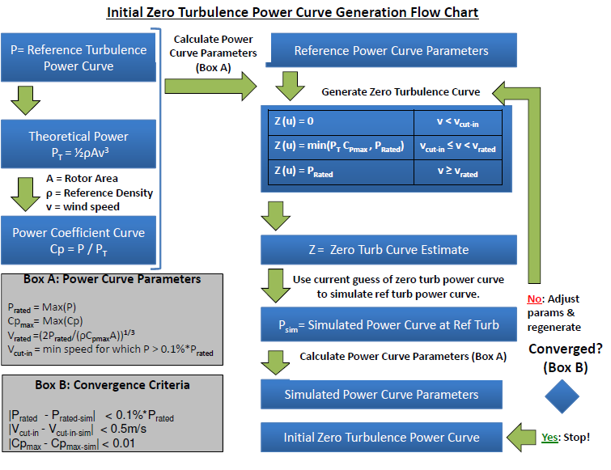
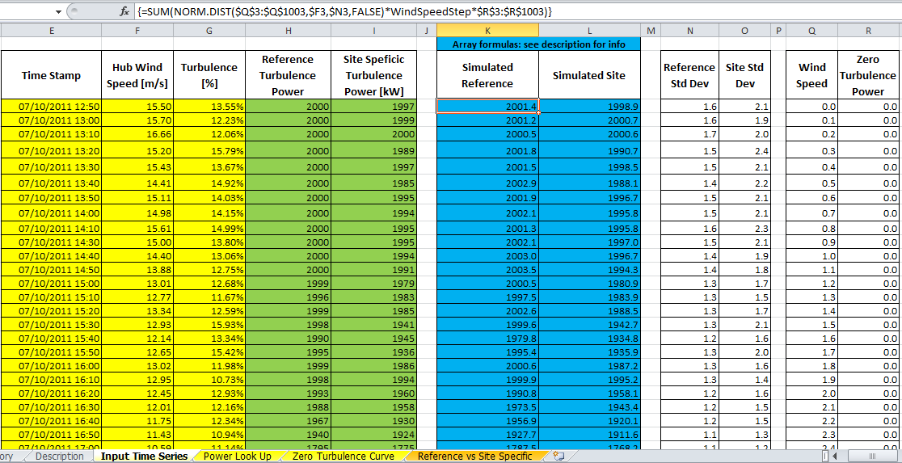
Open Source Excel Benchmarks
All methods examined by PCWG-Share-01 will have a publically available Benchmark.
Excel Consensus Analysis for IEC Turbulence Correction and Associated Documentation

Slide 12
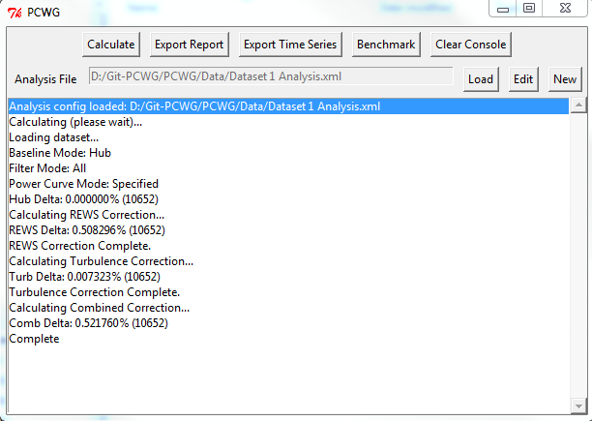
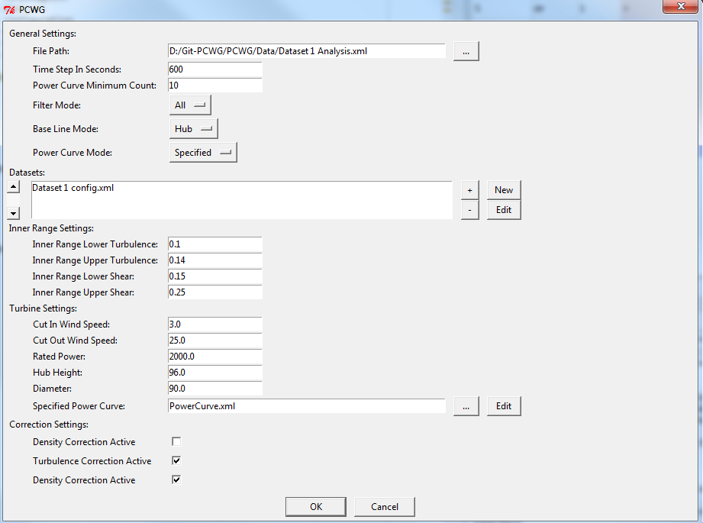
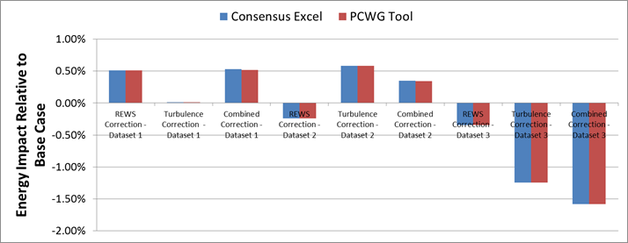
PCWG Analysis Tool
Excel Benchmark and PCWG Analysis Tool Comparison

Slide 13
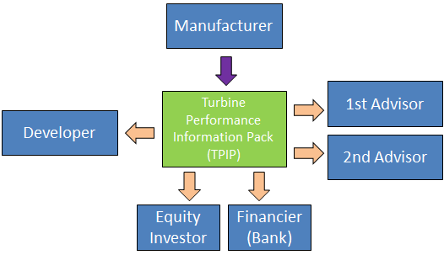
Harmonisation of Power Curve Communication
Another key action of the PCWG 2015 roadmap is the creation of a document to harmonise the communication of power curve information.
The guidelines aim to ensure that all stakeholders can confidently:
Understand the evidence base behind the documented turbine performance.
Understand what elements of the turbine performance data are warranted and what elements are purely informative.
Understand how to model turbine performance in Inner Range Conditions.
Understand how to model turbine performance in Outer Range Conditions.
A DRAFT document “Guidelines for Preparation of a Turbine Performance Information Pack” has been circulated to members and will be discussed at the June PCWG meeting.

Slide 14
Review Agenda

Slide 15
Objectives for 26th June 2015
Finalise Intelligence Sharing Definition Document
Discuss the draft Power Deviation Matrix Consensus Analysis.
Increase familiarity with the process of setting up datasets in the PCWG Analysis Tool
Establish a PCWG Beta Testing Group
Beginning discussions on the power curve information harmonisation document.
Any other objectives for today?

